Slide 1
Traffic Flow Prediction
A Hybrid Approach for Smart Traffic Prediction

Slide 2
Introduction
This presentation discusses a hybrid approach to traffic flow prediction using a combination of Partial Differential Equations (PDEs) and Physics-Informed Neural Networks (PINNs) / FNO. We aim to address the growing issue of traffic congestion in urban areas by utilizing advanced modeling techniques that improve the accuracy of predictions.

Slide 3
Motivation
01

Slide 4
Traffic congestion in cities
Traffic congestion is a significant issue in urban environments, leading to increased travel times, fuel consumption, and pollution. As cities continue to grow, the challenge of managing traffic flow becomes increasingly critical.

Slide 5
Need for improved management solutions
Current traffic management solutions often fall short of effectively addressing congestion. Advanced predictive models that integrate machine learning and PDEs can provide better insights and real-time data to improve traffic flow management.

Slide 6

Combination of machine learning and PDEs
The integration of machine learning techniques with Partial Differential Equations (PDEs) presents a powerful approach to traffic flow prediction. By leveraging the mathematical models provided by PDEs, particularly the Lighthill-Whitham-Richards (LWR) model, we can simulate traffic dynamics effectively. Machine learning algorithms, especially Physics-Informed Neural Networks (PINNs), can then refine these simulations by learning from historical traffic data, making predictions more accurate and responsive to real-world conditions.

Slide 7
Methodology
02

Slide 8

Data collection and preprocessing
To develop an effective predictive model, thorough data collection is essential. This includes gathering traffic density, average speed, and time-series data from various sources such as traffic sensors. Once collected, the data undergoes preprocessing which involves handling missing values, normalizing the data for consistent scales, and ensuring the quality and reliability of the dataset to improve the performance of subsequent modeling techniques.

Slide 9
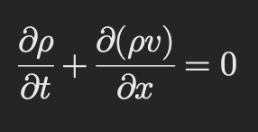
Advanced Lighthill-Whitham-Richards (LWR) model
The basic LWR model has limitations in representing complex traffic senarios, such as heterogenous traffic conditions (such as Diverse vehicles types,Varying speeds, Frequent Intersections).
The model treats traffic flow as a continuous flow rather than individual vehicles.
The LWR model is based on the conservation of vehicles and is described by the following continuity equation:

Slide 10
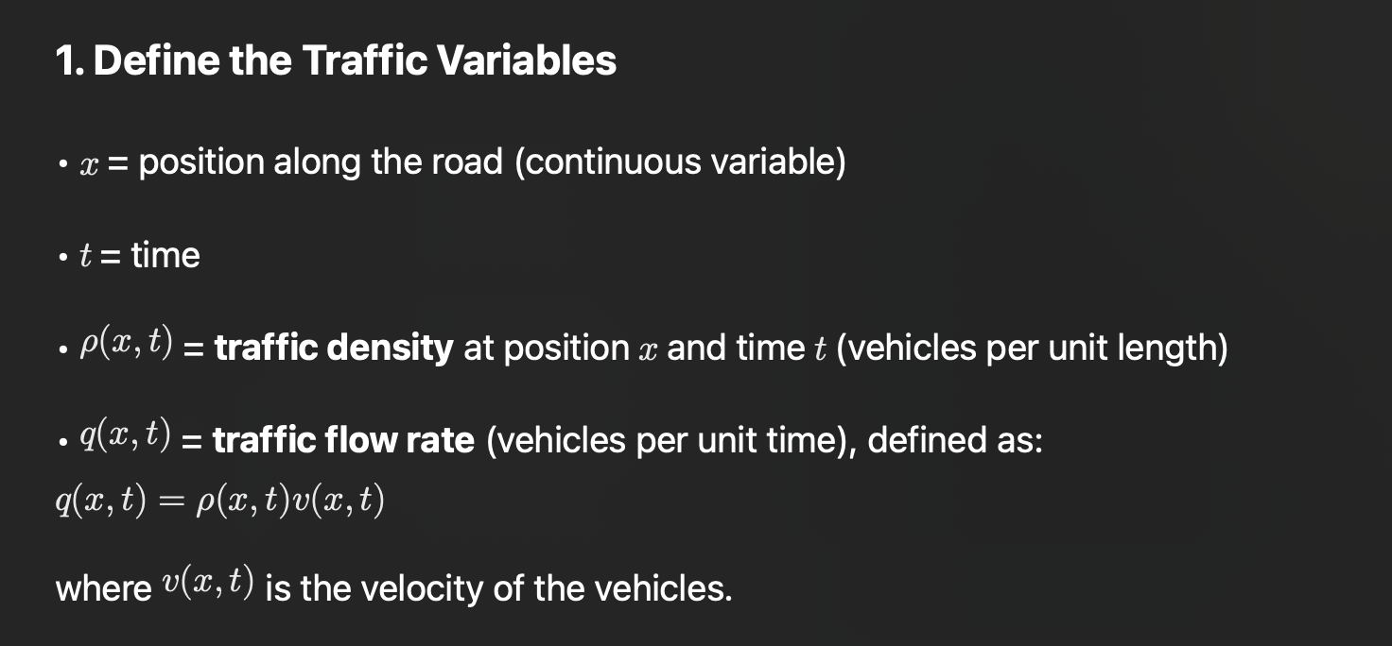

Slide 11
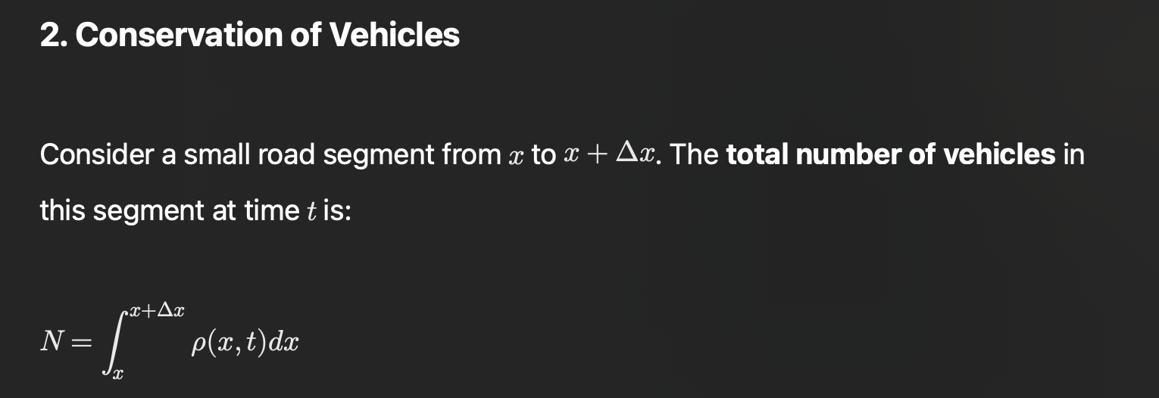

Slide 12
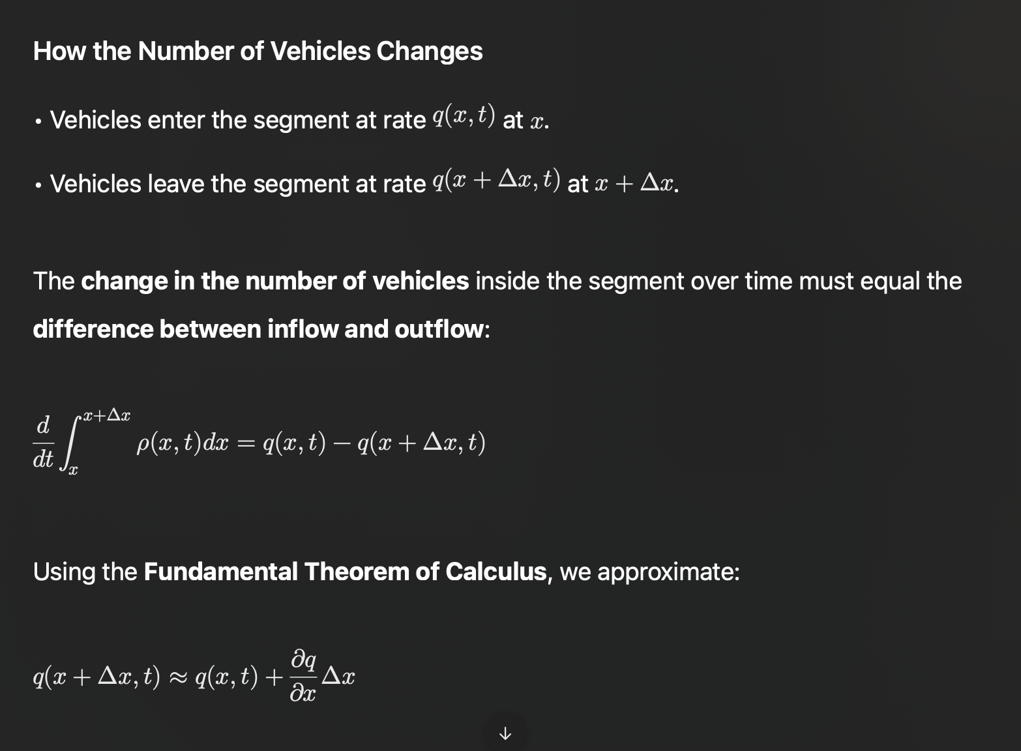

Slide 13
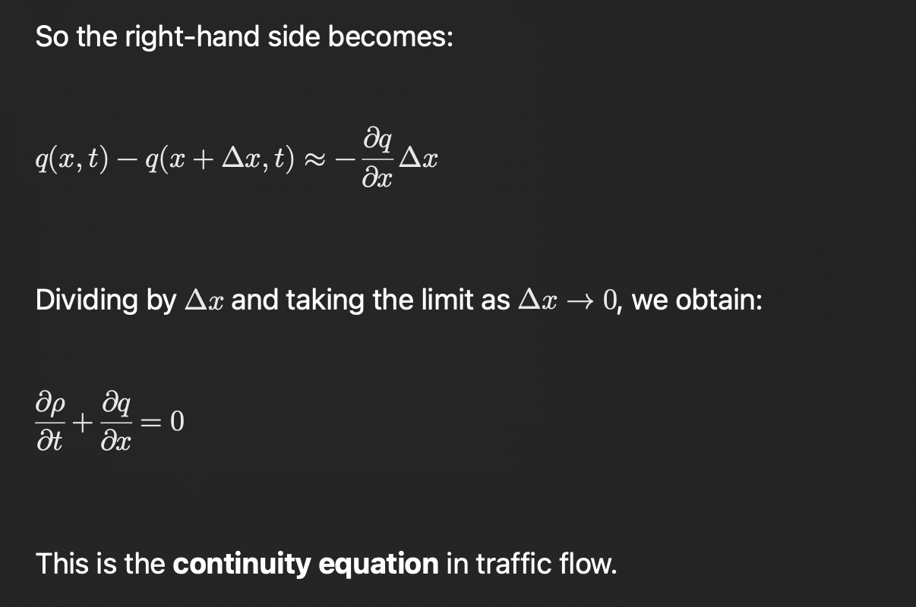

Slide 14
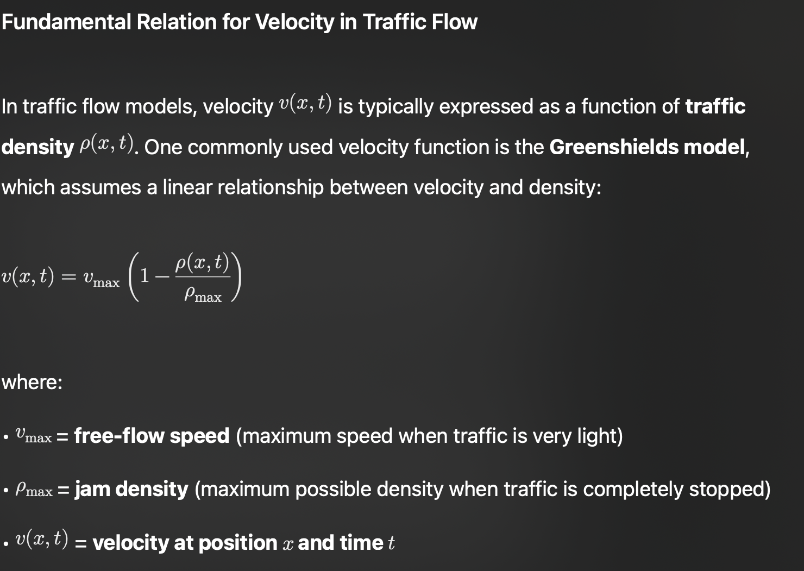

Slide 15
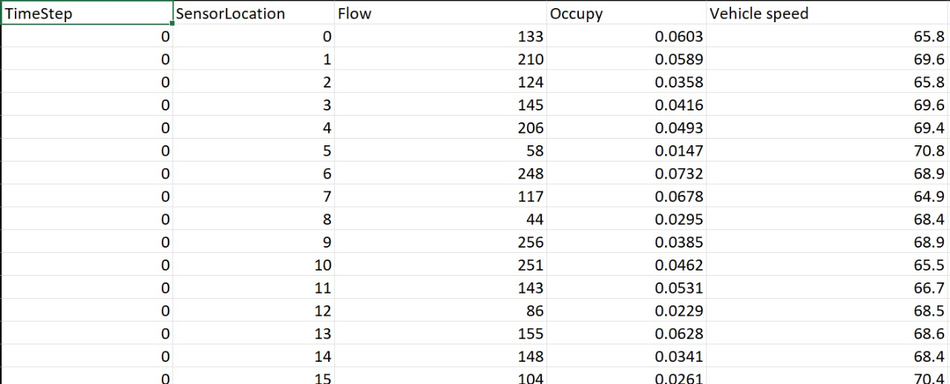
Our Data:-

Slide 16
We will predict the value of traffic through the LWR model then as we have
the actual data we will use Neural Techniques to reduce the errors in our
Model thus we will get an good estimate of the traffic flow.

Slide 17
PINN training process and loss function
Physics-Informed Neural Networks (PINNs) combine data-driven approaches with physical laws described by PDEs. The training process involves minimizing a total loss function that includes both data loss, which ensures the model adheres to observed data, and physics loss, which ensures the model respects the governing equations of the LWR model. This dual approach allows the PINN to improve predictions while adhering to physical constraints.

Slide 18
Conclusions
In conclusion, the combination of the LWR model and PINNs offers a significant advancement in predicting traffic flow. This hybrid approach not only enhances the accuracy of forecasts but also adapts to real-time traffic conditions, paving the way for smarter traffic management solutions that can alleviate congestion in urban areas.

Slide 19
Thank you!

